Slide 1

Coursera Capstone Project by Chandrasekhar Dwivedi
Opening a Shopping Mall in Paris

Slide 2
Business Problem:
Location of the shopping mall is one of the most important decisions that will determine whether the mall will be a success or a failure
Objective: To analyze and select the best locations in the city of Paris to open a new shopping mall
This project is timely as the city is currently suffering from oversupply of shopping malls
Business question: In the city of Paris, if a property developer is looking to open a new shopping mall, where would you recommend that they open it?

Slide 3
Data:
Data required:
List of neighborhoods in Paris
Latitude and longitude coordinates of the neighborhoods
Venue data, particularly data related to shopping malls
Sources of data:
Wikipedia page for neighborhoods: (https://en.wikipedia.org/wiki/Category:Districts_of_Paris)
Geocoder package for latitude and longitude coordinates
Foursquare API for venue data

Slide 4
Methodology:
Web scraping Wikipedia page for neighborhoods list
Get latitude and longitude coordinates using Geocoder
Use Foursquare API to get venue data
Group data by neighborhood and taking the mean of the frequency of occurrence of each venue category
Filter venue category by Shopping Mall
Perform clustering on the data by using k means clustering
Visualize the clusters in a map using Folium

Slide 5
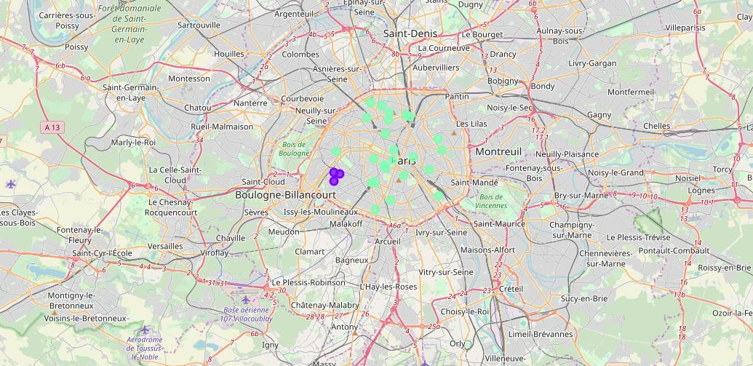
Results:
Categorized the neighborhoods
into 3 clusters:
Cluster 0: Neighborhoods with
moderate number of shopping
malls
Cluster 1: Neighborhoods with
low number to no existence of
shopping malls
Cluster 2: Neighborhoods with
high concentration of shopping
malls

Slide 6
Discussion:
Most of the shopping malls are concentrated in the central area of the city
Highest number in cluster 2 and moderate number in cluster 0
Cluster 1 has no shopping malls in the neighborhoods
Oversupply of shopping malls mostly happened in the central area of the city, with the suburb area still have very few shopping malls

Slide 7
Recommendations:
Open new shopping malls in neighborhoods in cluster 1 with little to no competition
Can also open in neighborhoods in cluster 0 with moderate competition if have unique selling propositions to stand out from the competition
Avoid neighborhoods in cluster 2, already high concentration of shopping malls and intense competition

Slide 8
Conclusion:
Answer to business question: The neighborhoods in cluster 1 are the most preferred locations to open a new shopping mall
Findings of this project will help the relevant stakeholders to capitalize on the opportunities on high potential locations while avoiding overcrowded areas in their decisions to open a new shopping mall

Slide 9

Thank You

